Slide 1


Constituency Connect
Group Members:
Muhammad Ahsan 21-ARID-737
Haseeb Ur Rehman 21-ARID-715
Huzaifa Bin Shahzad 21-ARID-719
Supervised By:
Ms. Farkhanda Qamar
UNIVERSITY INSTITUTE OF INFORMATION TECHNOLOGY

Slide 2
Table of Contents
Brief overview
Project Features
Stakeholders
Functional Requirements
Use-Case Diagram
Non-Functional Requirements
Block Diagram
Concept Diagram
System Sequence Diagram

Slide 3
1.Brief Overview
Bridges communication gaps between constituents and representatives.
Empowers citizens to voice concerns effectively and transparently.
Key features include:
Complaint Reporting with real-time updates.
Virtual Meetups for direct interaction.
Performance Tracking to monitor issue resolution.
Automated Notifications to keep users informed.
Promotes civic engagement and strengthens accountability.

Slide 4
2.Project Features:
Key Features
Complaint Reporting System
Report complaints, view history, and track status.
Route complaints to representatives or department handlers.
Prioritize urgent complaints for immediate action.
Survey and Polling System
Participate in surveys; create and analyze results.
Real-time survey results with visualizations for trends.
Data Analytics and Statistics
Displays complaint resolutions and survey statistics.

Slide 5
2.Project Features:
Key Features
Virtual Meetups
Schedule discussions with constituents.
Integrate with platforms like Zoom/WebRTC for video calls.
Feedback System
Gather public sentiment on representative performance.
Role-Specific Dashboards
Customized dashboards for Constituents, Representatives, and Handlers.
Event Calendar
Anonymous Reporting

Slide 6
3.StakeHolders
Primary Stakeholders
Constituents
Representatives
Department Complaint Handlers
Secondary Stakeholders
Video Conferencing Service Providers
System Administrators
Developers and Technical Teams

Slide 7
4.Functional Requirements
Users (Constituents and Representatives):
The system shall allow users (constituents and representatives) to register on the platform.
Users shall be able to log in to their accounts using valid credentials.
Constituents:
Constituents shall be able to report a complaint to their respective representatives through the system.
Constituents shall be able to track the status of their complaints.
Constituents shall have access to a history of their submitted complaints.

Slide 8
4.Functional Requirements
Constituents shall be able to track the status of their complaints.
Constituents shall have access to a history of their submitted complaints.
Constituents shall be able to view their representative's performance statistics, including (Total complaints received, number of complaints resolved, pending complaints, and Total meetups conducted etc).
Constituents shall be able to participate in surveys and polls organized by their representatives.
Constituents shall be able to attend virtual meetups arranged by their representatives.

Slide 9
4.Functional Requirements
Constituents shall be able to provide feedback on complaint resolutions and representative performance.
Representatives:
Representatives should only register with their official email address (e.g., johndoe@na.gov.pk).
Representatives shall be able to create and distribute custom surveys to gather insights from constituents.
Representatives shall have the ability to schedule and host virtual meetings with constituents.

Slide 10
4.Functional Requirements
Representatives shall be able to update the status of complaints to reflect progress or resolution.
Representatives shall be able to forward complaints to the relevant departments for action.
Representatives shall be able to post-event calendars displaying upcoming community events and public meetings.
Representatives shall be able to run awareness campaigns.

Slide 11
4.Functional Requirements
Department Complaint Handlers:
The Department Complaint Handler shall be able to update the status of complaints to reflect progress or resolution.
Miscellaneous:
Notify constituents about complaint updates and upcoming meetings.
Display survey results using charts and graphs.
Highlight sensitive complaints for urgent action.

Slide 12
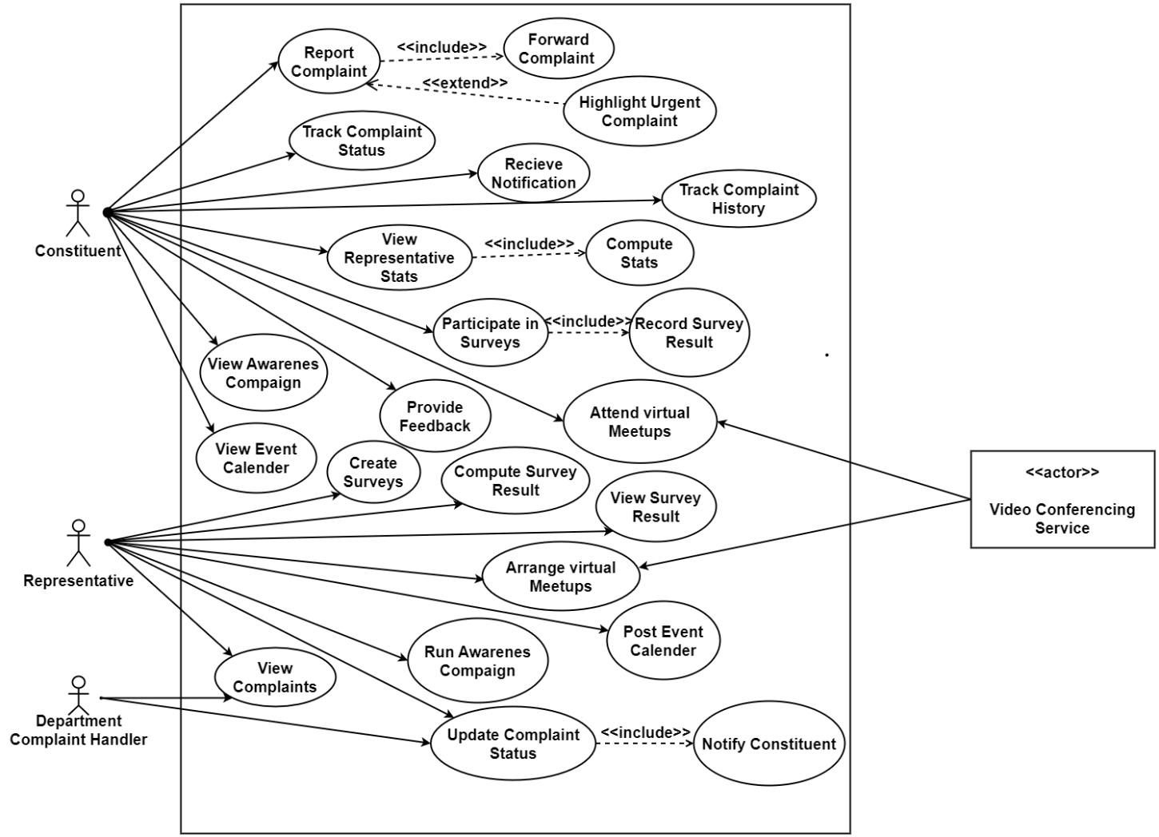
5.Use-Case Diagram

Slide 13
6.Non-Functional Requirements
The system must load each page within 2 seconds for 95% of user interactions.
The engineers should scale the system to support up to 10,000 concurrent users.
The system must ensure 99.9% uptime availability, allowing no more than 8 hours of downtime annually.
The system must provide complaint submission confirmation within 2 seconds.
The system should support browser compatibility for the latest two versions of Chrome, Firefox, Edge, and Safari.
The system must handle complaint routing with a response time of under 2 seconds per action.
User sessions should time out after 30 minutes of inactivity for enhanced security.

Slide 14
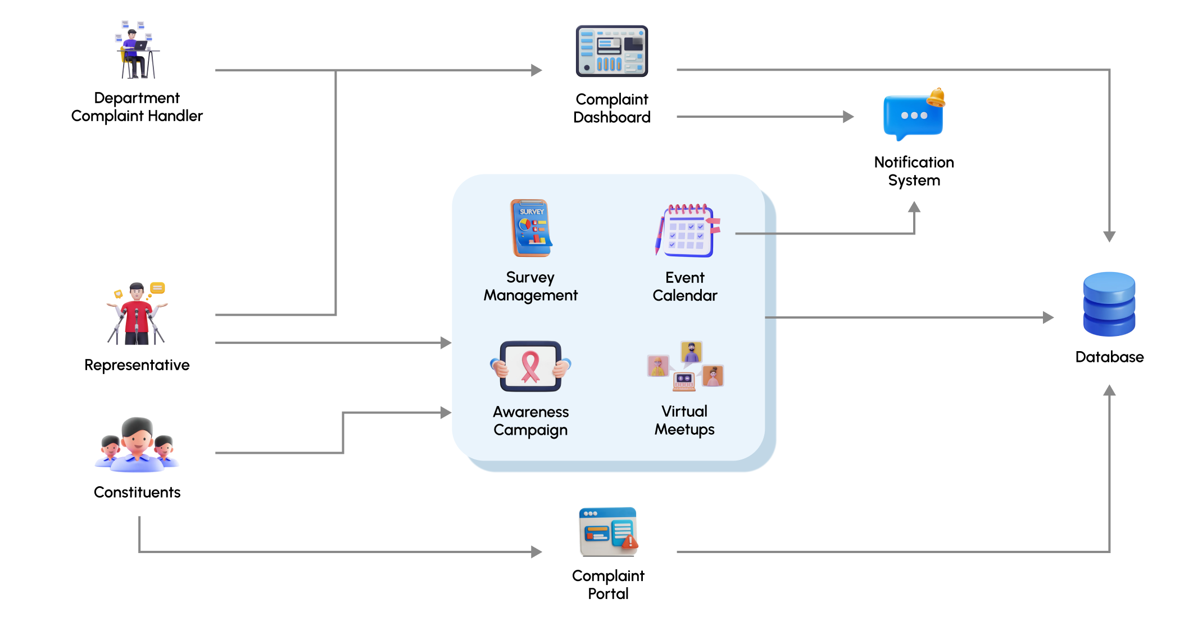
7.Block Diagram

Slide 15
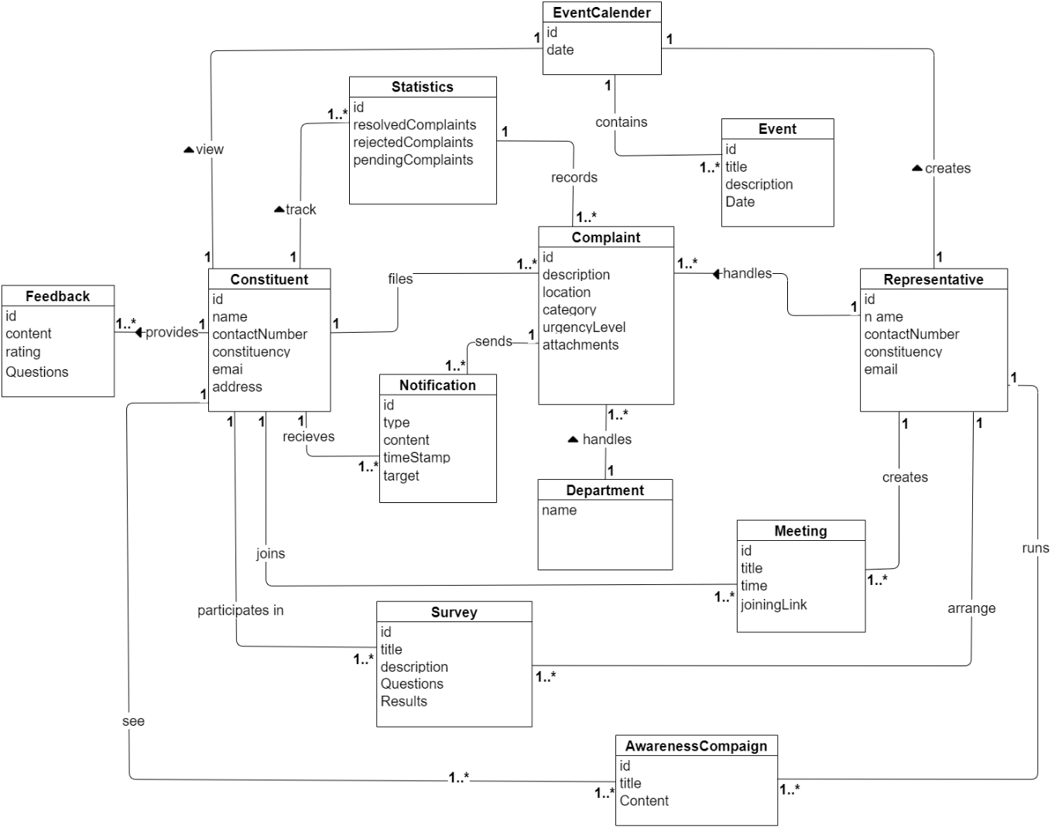
8.Concept Diagram

Slide 16
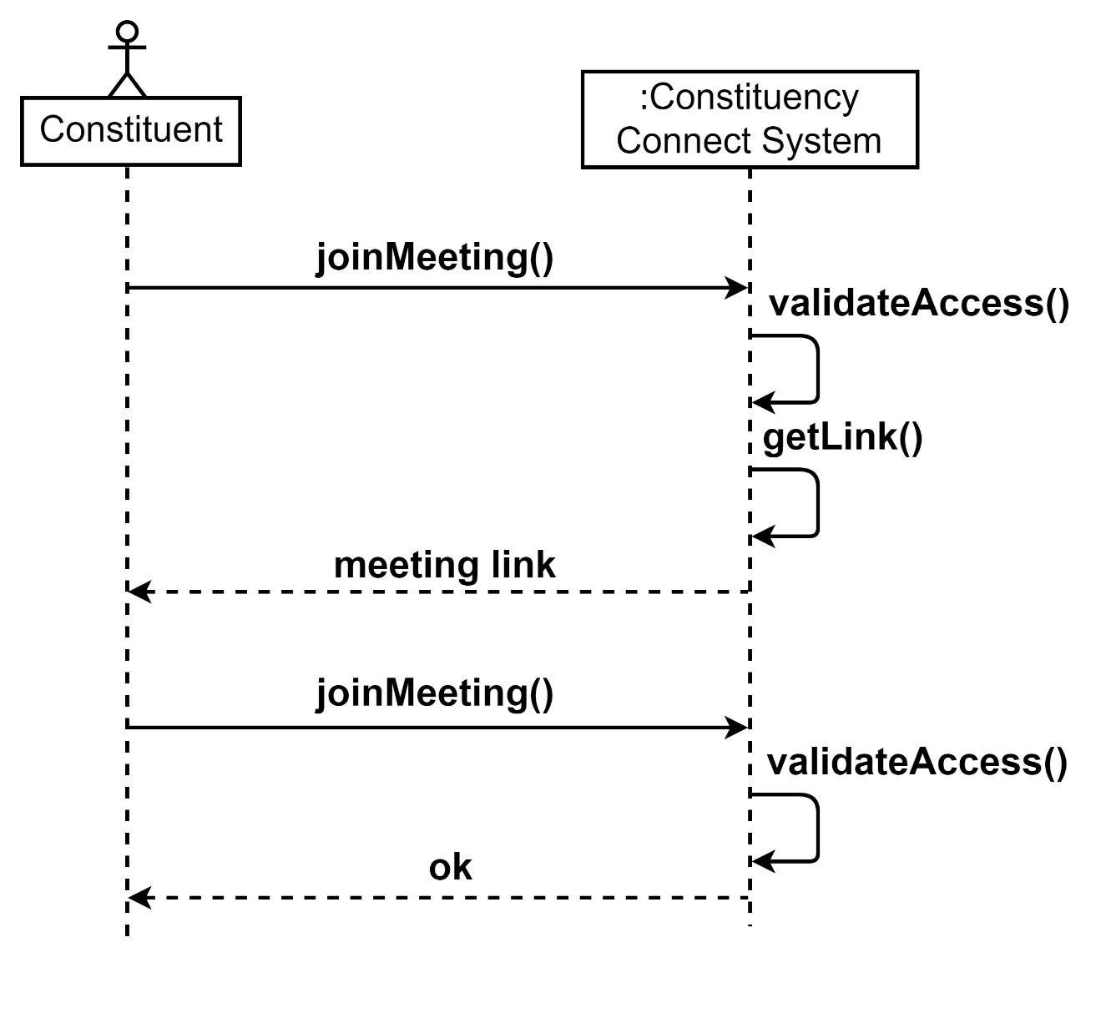
9.System Sequence Diagram

Slide 17
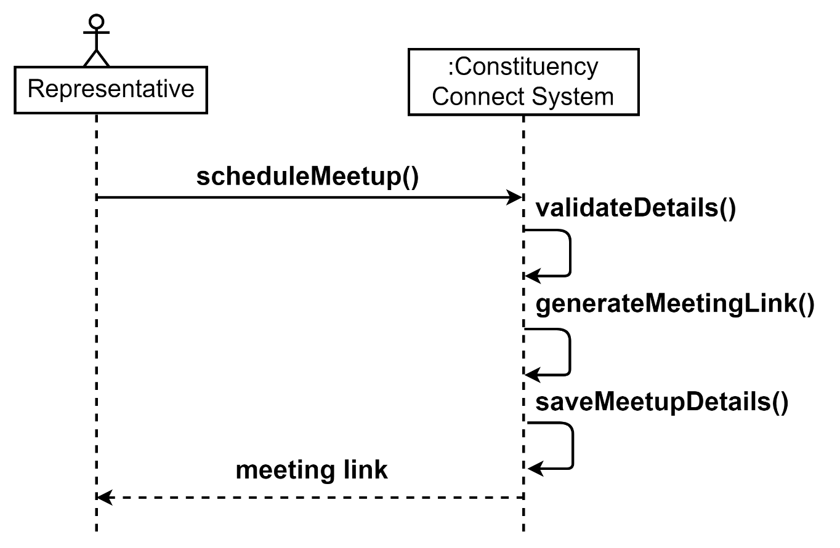
9.System Sequence Diagram

Slide 18
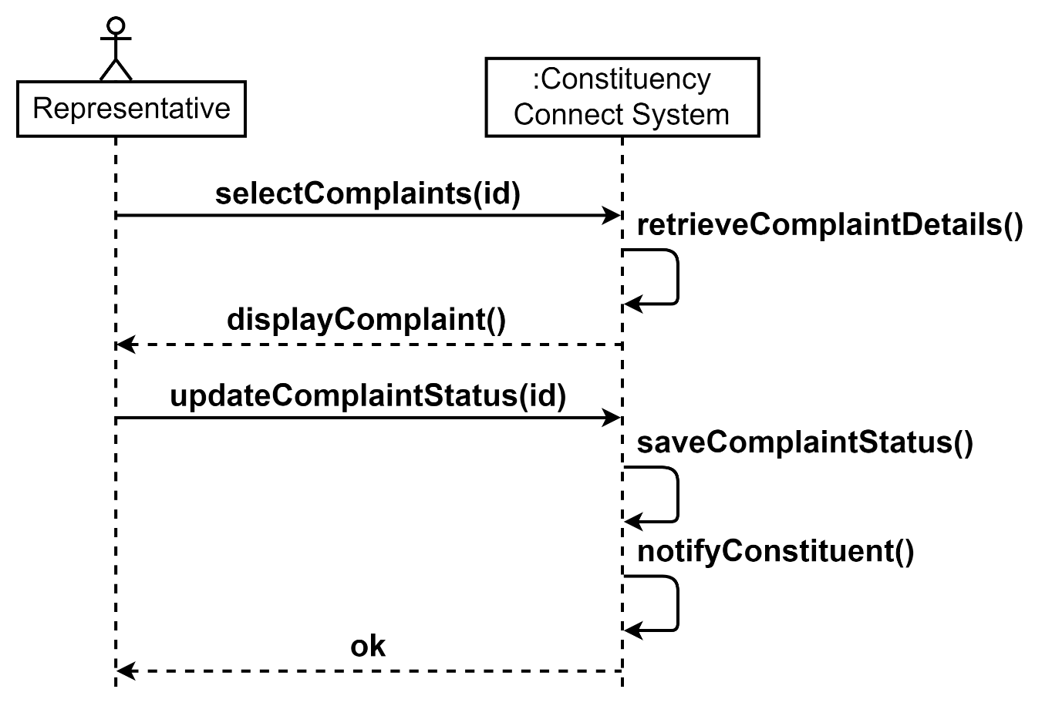
9.System Sequence Diagram

Slide 19
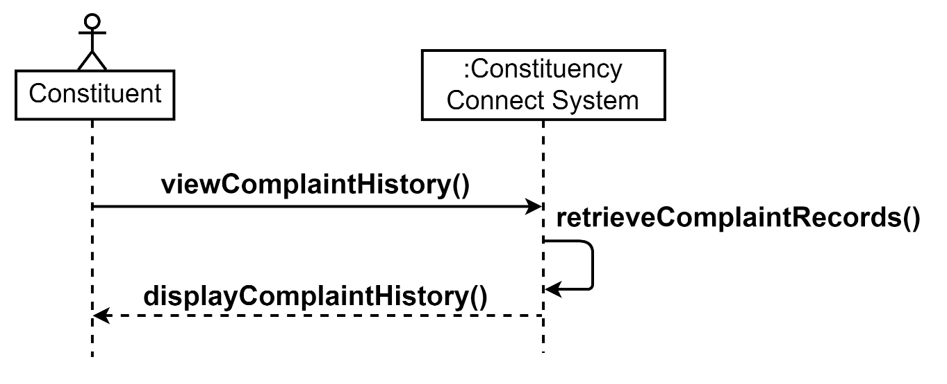
9.System Sequence Diagram

